Slide 1
Texture Synthesis using wang tile and graph cut
Progress final
9757553 顏志晟

Slide 2
Outline
Traditional Problem about Wang tile
Paper Solution
Implement Problem
Our approach
Result

Slide 3
Traditional Problem

Slide 4
Motivation - Corner problem

Slide 5
Motivation-- Joint problem

Slide 6
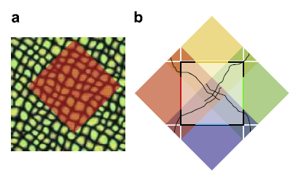
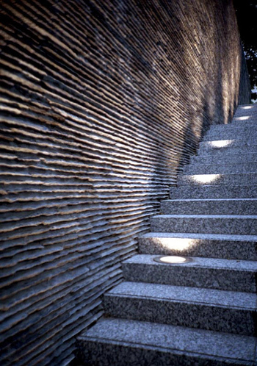
Motivation—sampling problem

Slide 7
Paper Solution

Slide 8
Strict Wang tile
No sampling problem
But Need many precomputatative time

Slide 9
Implement Problem

Slide 10
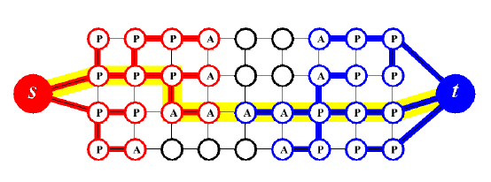
Problem 1—Graph cut?
Edmonds-Karp algorithm and Ford-Fulkerson algorithm is very slow due to recursively call

Slide 11

How to connect Graph cut

Slide 12
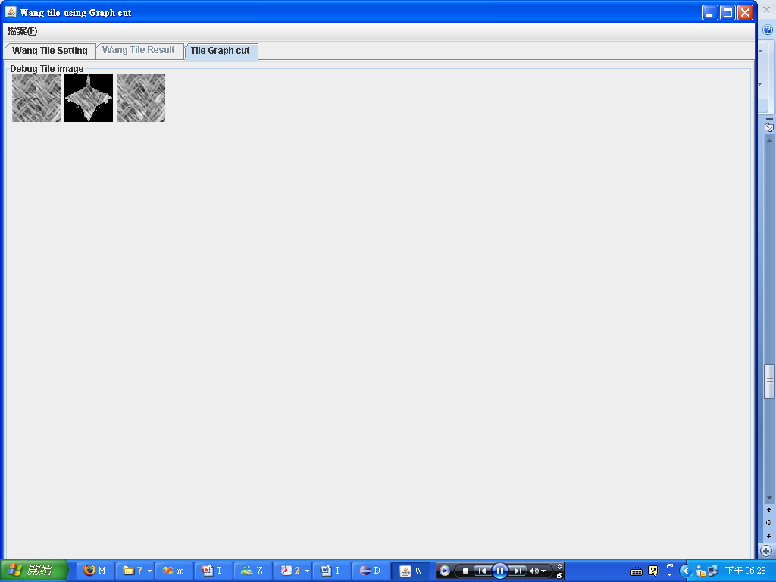
Graph cut Result

Slide 13
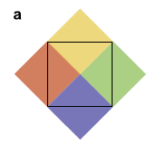
Problem2

Slide 14
Our approach

Slide 15
學長的可行方法

Slide 16
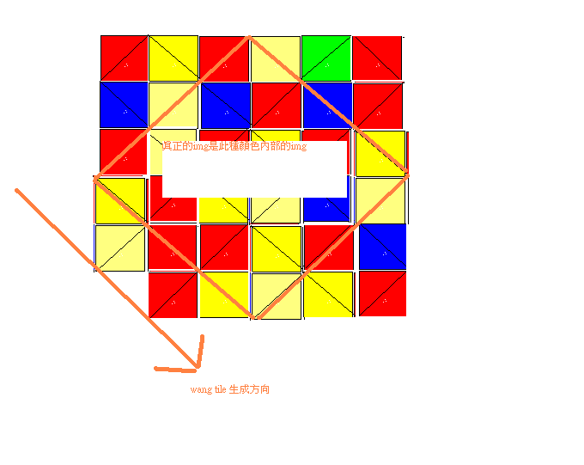
Solution1

Slide 17
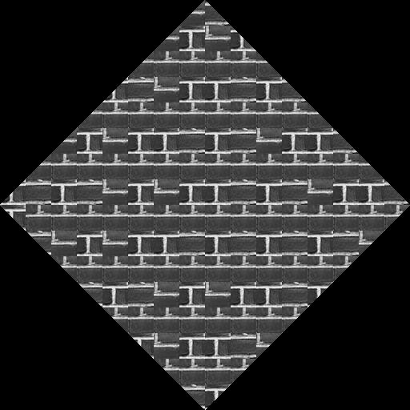
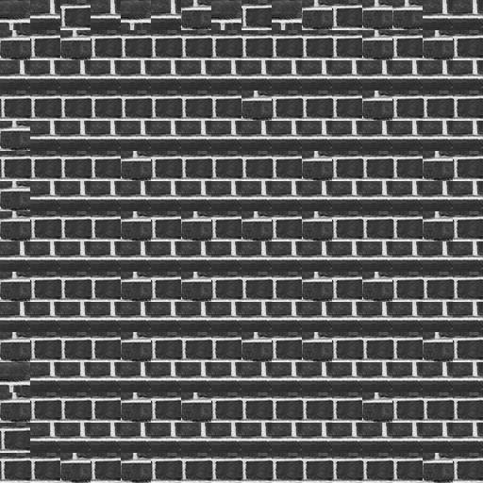
Problem for Solution 1

Slide 18
Solution 2

Slide 19
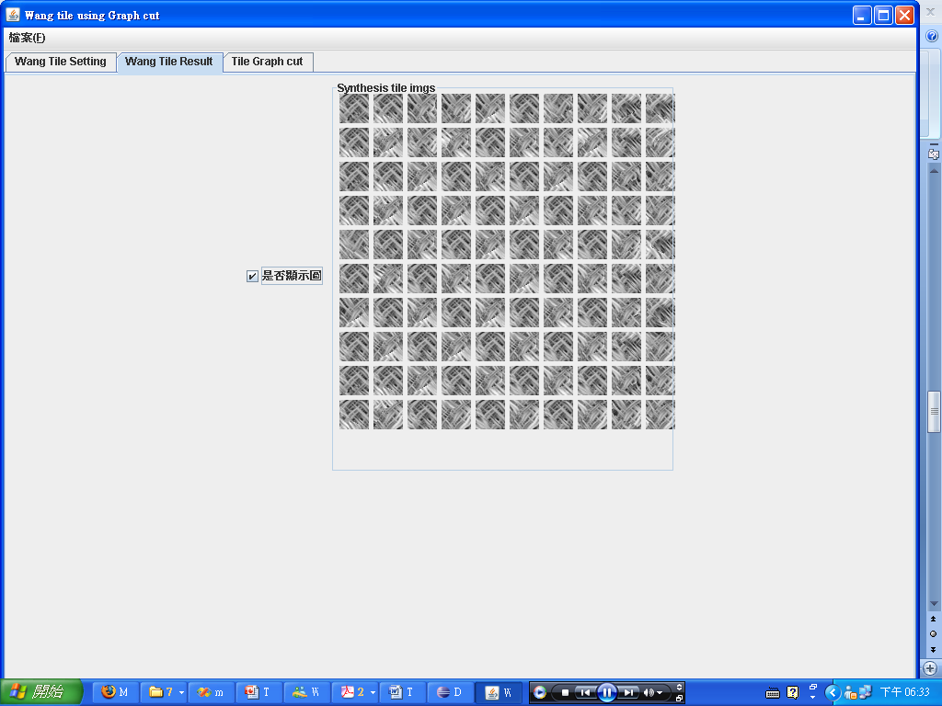
Result for Solution 2

Slide 20
Some Demo

Slide 21
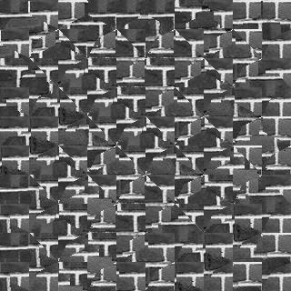
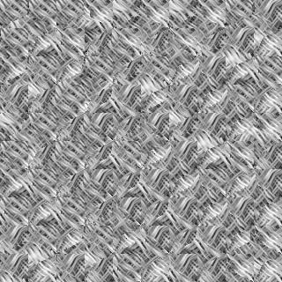
Result

